Slide 1
Adding Share Extension to Flock
* Not Easy..

Slide 2
Extensions
Extensions were introduced in iOS 8 along with packageable Dynamic Frameworks.
Some popular ones:
Share | Today | File or Document Provider

Slide 3
How do you build them?
Go watch the WWDC videos.
Or sit through this boring presentation and then go watch the WWDC videos.

Slide 4
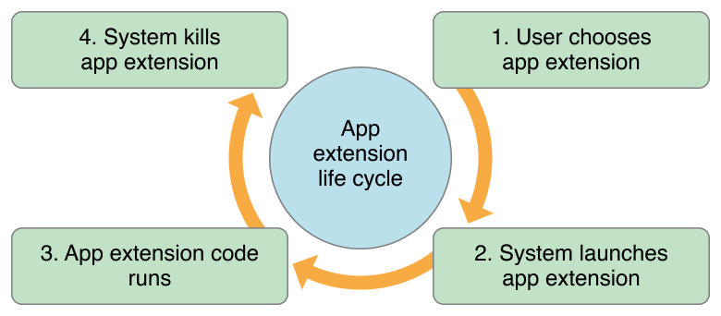
Thanks for the photo apple!

Slide 5
Key theme: Sharing your data between the app and the extension
Extension is a standalone entity. Runs as a separate process.
Cannot talk to app directly.
Share data through 1) App Groups 2) Keychain Sharing

Slide 6
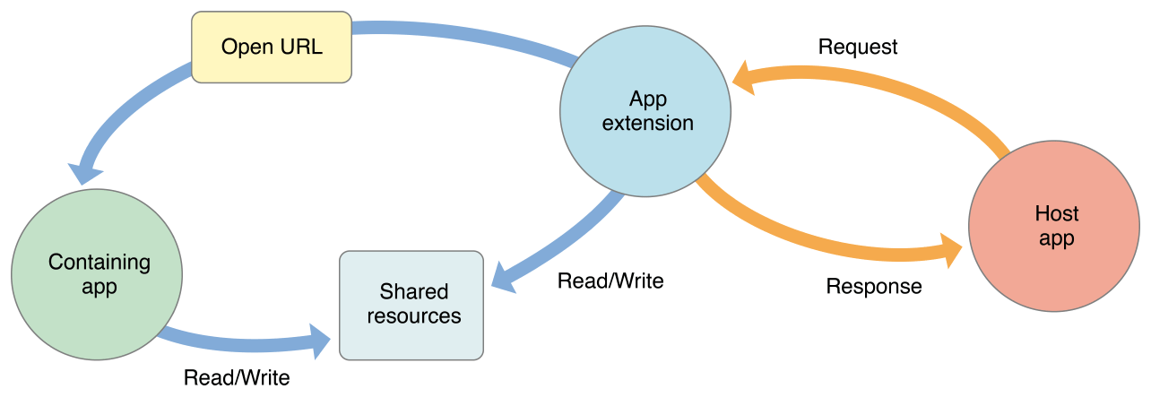
Thanks again apple! I owe you one.

Slide 7
Sharing your data model layer
Apple recommends extracting your data model into a shared framework to be used by app and extension.
Two ways to achieve that:
Use static libraries linked with cocoapods help. { My way }
Use dynamic (embedded) frameworks. { Or the highway }

Slide 8
Pro-tips and Tricks
If you want to exchange data realtime between app and extension, treat it like IPC. Berkley (Unix) sockets or system notifications can be used to detect changes in core data MOC’s
App extensions cannot access [UIApplication sharedApplication].
Share extensions only get a few seconds to launch.

Slide 9
Logging
Log we must. When errors shall occur.
Yoda
App extensions should also log errors and redirect console logs to file in a shared container. This can be then accessed by main app. Also, ensure auth tokens are not exposed while logging.
But you already know this stuff, so ¯\_(ツ)_/¯

Slide 10

We might have a larger neocortex, but some species will still be cooler than we are.

Slide 11
Gotcha #1
Version for the containing app and all the extensions is required to be same. This includes the build number too.

Slide 12
Gotcha #2
If creating stream to Door, use a different stream ID from the containing app.
Also note that the ID should be changed for each stream creation. Yatin knows more about this.

Slide 13
Handling presentation
The first View Controller is presented without any animation. To show a Modal effect, we make this VC transparent and present the second VC modally.

Slide 14
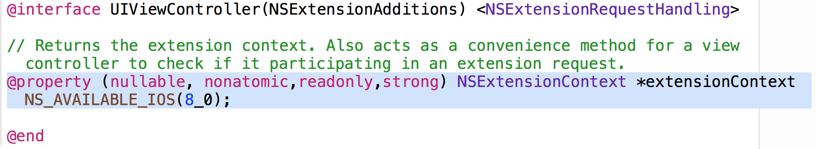
Getting the item to be shared

Slide 15
Dynamic Frameworks
The framework is built and linked dynamically by the app as well as the extension.
Cocoapods (<1.0) creates issues when you link a pod to a dynamic framework, when that same pod is also linked to any of the app or the extension.

Slide 16
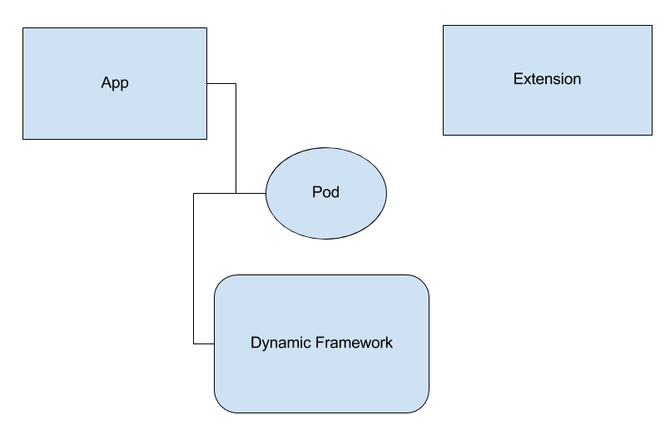

Slide 17
Protocol conformance in categories
Smaller files
Added friction to create a stored property. Reliance on instance properties reduced.
We considered this as a replacement for #pragma.

Slide 18
Dropped iOS 7
Extensions not supported below that version.
Embedded frameworks to be imported using dlopen.
Moving towards newer iOS APIs - UIAlertController, UISearchController.

Slide 19
Network calls in background
[NSURLSessionConfiguration backgroundSessionConfigurationWithIdentifier:@”ID”]
configuration.sharedContainerIdentifier = TDTAppGroupContainerIdentifier;
Uploads/Downloads continue even when containing app terminated.
Force quitting by users cancels these transfers.

Slide 20
Next Steps:
Cocoapods 1.0
Multiple Image sharing
Additional kUTType sharing - URLs, text etc
This will handle sharing from Safari too, which gives URL data.
Non blocking UI for sharing
Possible other extensions:
Today extension to
Show recent messages with default reply options
Possible chat options (open app on tap)

